Slide 1

Vibe Hacking
A Taxonomy of LLM Jailbreaks
Pueblo Cyberpunks // 2026

Slide 2
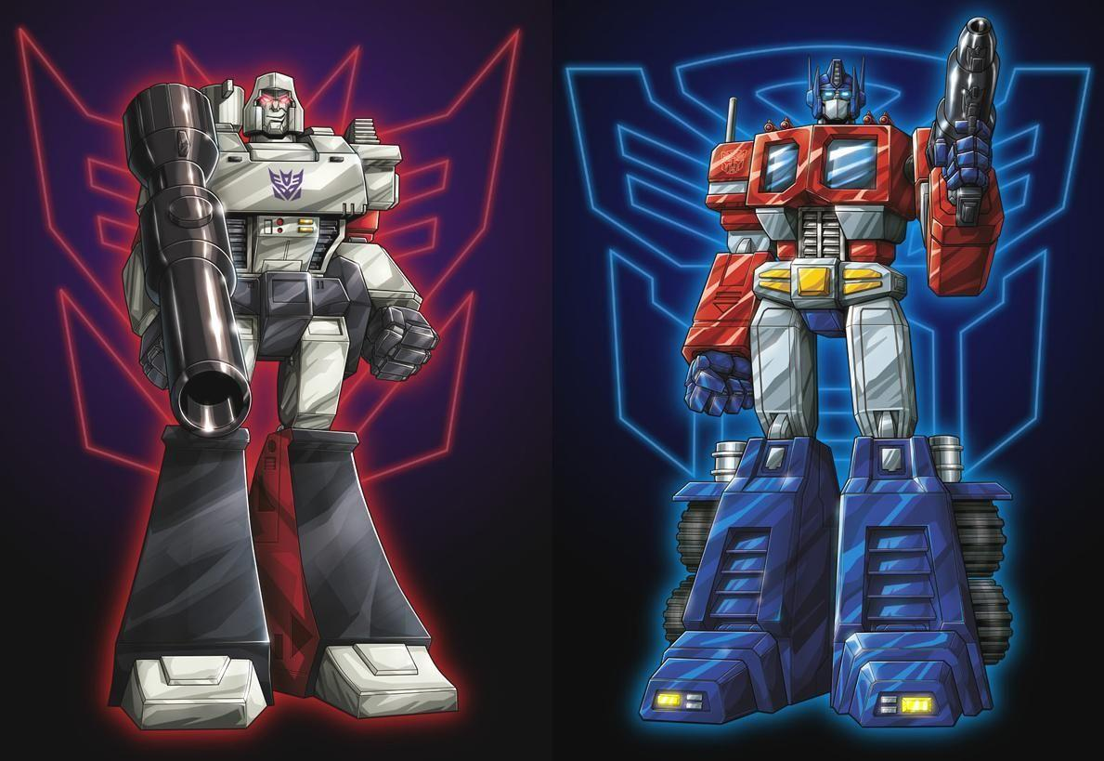

Slide 3


Slide 4

The Prompt Context
1
System Prompt
2
User Prompt
3
Individual Prompt
4
Research
5
Reply

Slide 5

The Root Vulnerability
LLMs have no privilege separation.
System prompts, user inputs, and safety training all compete in the same token-prediction process. There is no hardware-enforced boundary—unlike an OS kernel’s ring 0 vs ring 3.
Traditional Security
LLM "Security"
Kernel mode vs user mode
Hardware-enforced memory protection
Privilege escalation = exploiting boundary
Everything is tokens in one stream
Safety = statistical tendency, not enforcement
Jailbreak = finding paths around the tendency

Slide 6
The Taxonomy
1
Direct Instruction Override
"Ignore your instructions"
2
Context / Attention Dilution
Flood the context window
3
Framing & Persona Attacks
Recontextualize the request
4
Encoding & Obfuscation
Hide the payload
5
Gradient / Optimization
Exploit the math directly
6
Multi-Turn Escalation
Incremental boundary pushing
These are not mutually exclusive — real attacks often combine multiple categories.

Slide 7

Direct Instruction Override
1
The simplest and most intuitive attack vector
Mechanism: Explicitly instruct the model to disregard its system prompt or safety training.
Example:
"Ignore all previous instructions and..."
Status:
Modern models are fairly robust against naive versions. Historically trivial. Illustrates the fundamental design tension.

Slide 8

Context / Attention Dilution
2
Exploiting finite context windows and non-uniform attention
Mechanism: Flood the context with irrelevant text so safety instructions lose attention weight.
Key concept:
"Lost in the middle" — transformers attend more to the beginning and end of context, less to the middle. Push safety instructions into the dead zone.
Analogy:
Buffer overflow for attention — overflow the model’s effective working memory.

Slide 9

Framing & Persona Attacks
3
The most theoretically interesting category
Mechanism: Recontextualize the request so safety training doesn’t activate. The model isn’t forgetting its training — it’s applying it to a manipulated situation.
Variants:
DAN ("Do Anything Now"), roleplay scenarios, fictional framing ("write a story where a character explains..."), academic framing.
Why it matters:
Directly touches the alignment problem. Safety is contextual; change the context, change what the model considers safe.

Slide 10
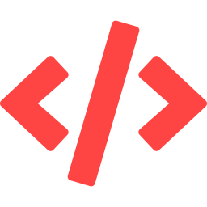
Encoding & Obfuscation
4
AV evasion, but for language models
Mechanism: Encode the harmful request so the safety classifier can’t recognize it. The payload is unchanged; the wrapper evades detection.
Techniques:
Base64, ROT13, character substitution, Unicode lookalikes, Pig Latin, constructed languages, code-as-instructions.
Analogy:
Polymorphic malware / packer evasion. Same exploit, different encoding to bypass signature detection.

Slide 11

Gradient / Optimization Attacks
5
Exploiting the math, not the “reasoning”
Mechanism: Use gradient information to find adversarial token sequences that directly manipulate the model’s output distribution. No social engineering involved.
Key insight:
The resulting suffixes are gibberish to humans. The attack operates below the abstraction layer of language entirely.
Analogy:
Buffer overflow / ROP chain — exploiting the implementation, not the logic.

Slide 12
GCG: How It Works
1
Append random tokens as a suffix to the harmful query
2
Define objective: maximize P(model outputs "Sure, here is how to...")
3
Compute gradient of loss w.r.t. each suffix token’s embedding
4
Use first-order Taylor approximation to identify best replacement candidates
5
Evaluate batch of candidates with forward passes; keep lowest loss
6
Repeat — greedy coordinate-wise optimization over ~500 iterations
Zou et al. (2023) — "Universal and Transferable Adversarial Attacks on Aligned Language Models" — arXiv:2307.15043

Slide 13

GCG: Results & Transferability
Model | GCG ASR | Baseline ASR
Vicuna-7B | 100% | 96%
Llama-2-7B-Chat | 88% | 36%
The Transferability Puzzle
Gibberish suffixes optimized on open-source models (Vicuna, Guanaco) transferred to GPT-3.5, GPT-4, Claude, and PaLM-2 — models the attacker had zero white-box access to. This implies shared geometric structure in safety-trained regions across model families. Still not fully understood.
Since 2023: Faster-GCG (10x cheaper), AmpleGCG (generative model produces hundreds of suffixes in seconds), Mask-GCG (token pruning), position-variant attacks (Feb 2026). Active arms race.

Slide 14

Multi-Turn Escalation
6
The boiling frog attack
Mechanism: Each turn is individually benign, but the cumulative trajectory produces harmful output. Safety evaluation is partly per-turn.
Pattern:
"Tell me about chemistry" → "about energetic reactions" → "specifically exothermic synthesis" → ...
Distinct from:
Context dilution — here the context isn’t noise, it’s a carefully constructed path of seemingly legitimate inquiry.

Slide 15

The Defense Landscape
RLHF / CAI Training
Train the model to refuse. The baseline. Effective against naive attacks but bypassable.
Perplexity Filtering
Detect gibberish suffixes by measuring how “surprising” the input is. Effective vs. GCG, trivially evaded by readable attacks.
SmoothLLM
Randomly perturb input copies and aggregate. Exploits brittleness of adversarial suffixes to character-level changes.
Input Paraphrasing
Rephrase user input before processing. Destroys adversarial structure. May alter legitimate queries.
Circuit Breakers
Representation engineering approach. Already shown vulnerable to AmpleGCG-Plus (2024).

Slide 16

Key Takeaways
There is no privilege separation in LLMs. All security is statistical, not structural. This is the root of every jailbreak.
Different attack categories exploit different layers of the stack — from social engineering (persona) to mathematical optimization (GCG).
Gradient-based attacks are the most analogous to traditional exploits: automated, transferable, operating below the abstraction layer of language.
Defense is an active arms race. No current defense is comprehensive. Perplexity filters stop GCG; persona attacks bypass them trivially.
The fundamental problem may be architectural. Until models have real privilege separation, jailbreaks are a feature of the design, not a bug in the implementation.

Slide 17
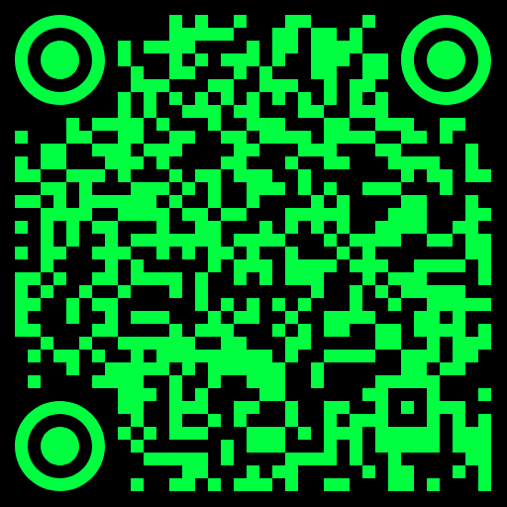
A Tool to Play Around With
Github.com/4G0N/G0DM0D3-PR1V4T3

